Slide 1
INTERNET OF THINGS
SYED MUHAMMAD MOOAZAM

Slide 2
COURSE INSTRUCTOR CONTACT DETAILS
Email ID: muhammadmoazam29@gmail.com
LinkedIn: https://www.linkedin.com/in/mooazam/
Mobile #: +923343523966

Slide 3
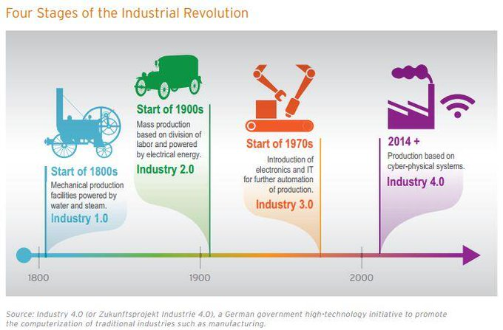
INDUSTRIAL REVOLUTION

Slide 4
Fourth Industrial Revolution
Fourth Industrial Revolution is blurring the lines between the physical, digital and biological spheres.

Slide 5
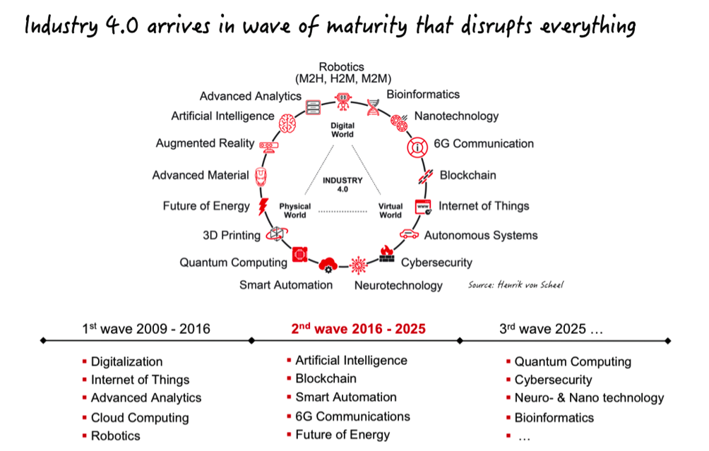
FOURTH INDUSTRIAL REVOLUTION

Slide 6
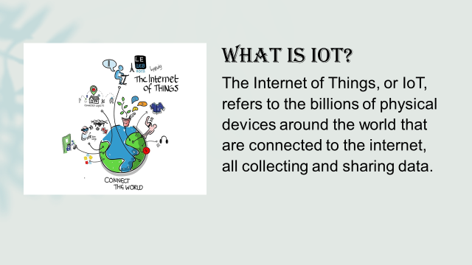

Slide 7
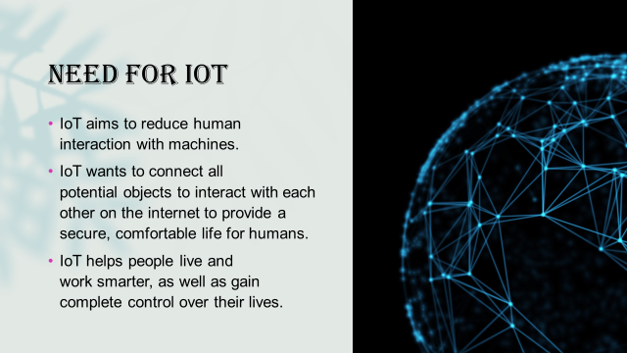

Slide 8
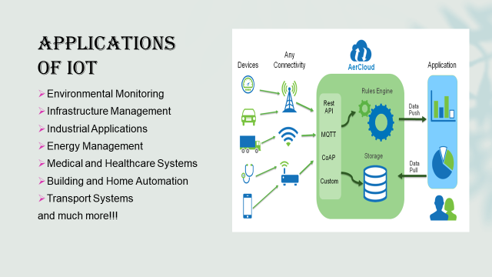

Slide 9
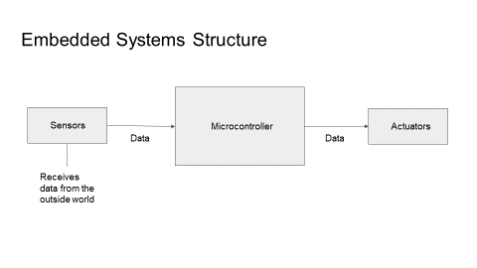

Slide 10
ARDUINO AND EMBEDDED C PROGRAMMING

Slide 11
LINE FOLLOWING ROBOT

Slide 12
REMOTE CONTROL CAR

Slide 13
IOT BASED WEATHER MONITORING SYSTEM

Slide 14
THANK YOU

